Slide 1
F# Primer for C# Developers
https://github.com/srpeterson/fsharp-csharp-developers

Slide 2



Steve Peterson
Nasdaq
Stephen.Peterson@outlook.com
Twitter: @steverpeterson
(all the code, info and slides)
https://github.com/srpeterson/fsharp-csharp-developers

Slide 3
What’s on the menu…
Introduction to F#
Functional C# language features
Direct comparison of F# and C#
Soo.. Why use F#?
F# Resources
Conclusion
Disclaimer!!!
This goal of this talk is not to teach you F#!
But rather…
https://github.com/srpeterson/fsharp-csharp-developers

Slide 4
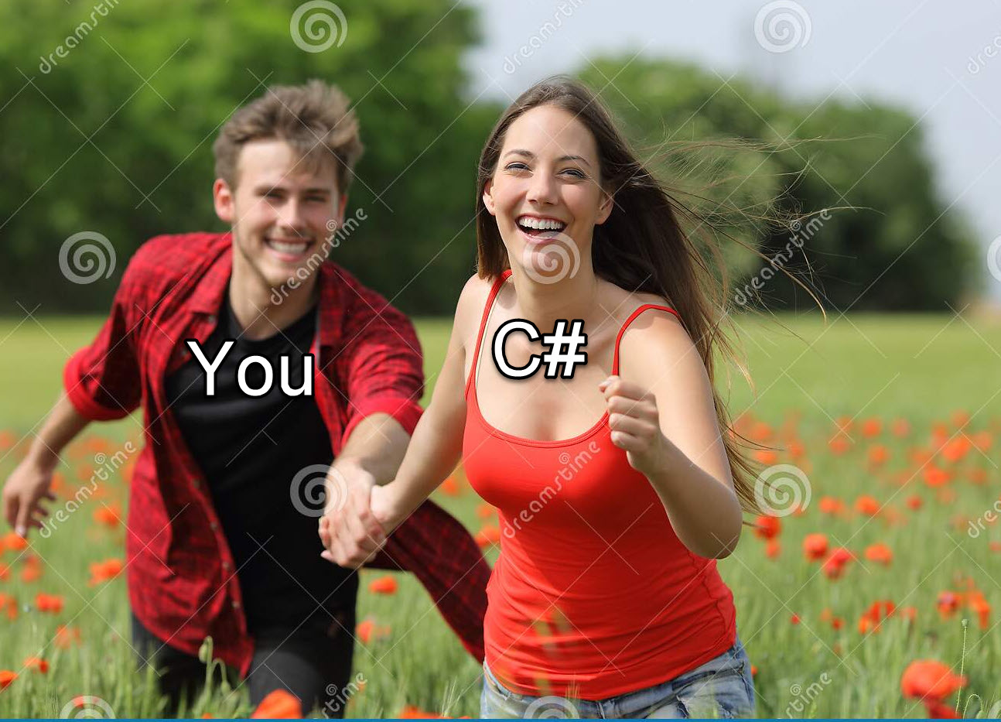
https://github.com/srpeterson/fsharp-csharp-developers

Slide 5
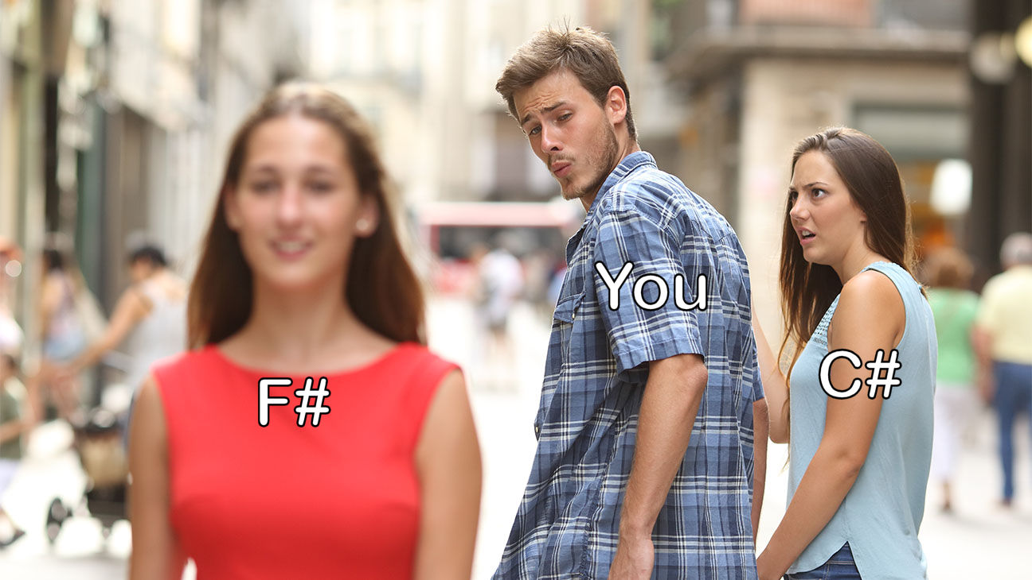
https://github.com/srpeterson/fsharp-csharp-developers

Slide 6

Introducing F#
First shipped with Visual Studio 2010
First class citizen of the .NET language family
Is a functional first language
Is open source
Fully interoperable with C# libraries and vice versa
https://github.com/srpeterson/fsharp-csharp-developers

Slide 7

Comparing C# to F#
Object Oriented (OOP)
Mutable by default
Null allowed
Reference typed
No dependency order
Functional first language
Immutable by default
Null is not allowed
Static Value typed
Enforced dependency order
More to come…
https://github.com/srpeterson/fsharp-csharp-developers

Slide 8
Comparing C# to F#
Imperative
Classes for data and behavior
Interfaces
Inheritance
Declarative
Types
Function Type
Nope!! Open what ya need!
Not done yet…
https://github.com/srpeterson/fsharp-csharp-developers

Slide 9
Comparing C# to F#
Huh???
No clue, sir!
What the…???
No way!! Really???
Drawing a blank here, man!
Algebraic Type System (And/Or)
Option Type (Some/None)
Result Type (Ok/Error)
Units of Measure
Script (.fsx) files
On to actual examples…!
https://github.com/srpeterson/fsharp-csharp-developers

Slide 10
Soo.. Why F#?
Never have to worry about nulls!
Less and more succinct code
Compiler enforces correct code
F# Interactive allows you to test code as you write it
Self documenting code
Focus on “what” not the “how”
Makes you a better C# developer!
https://github.com/srpeterson/fsharp-csharp-developers

Slide 11
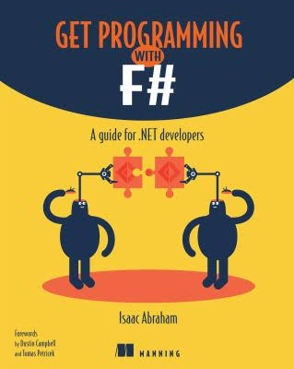
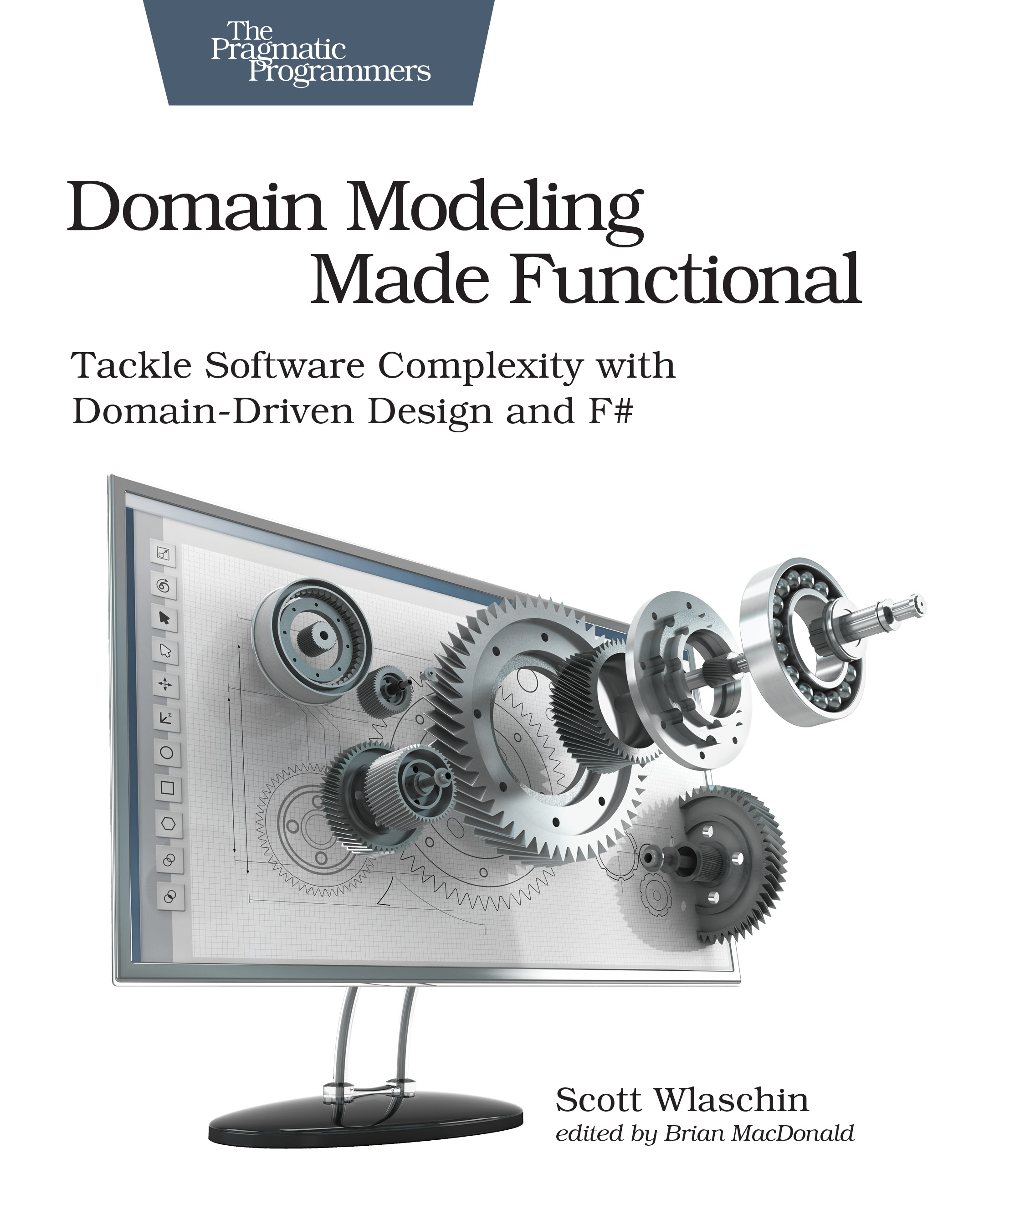
F# Resources - Books
Get Programming with F#
Domain Modeling Made Functional
Isaac Abraham
Scott Wlashin
https://github.com/srpeterson/fsharp-csharp-developers

Slide 12
F# Resources - Online
https://fsharp.org/ - Official F# site with mentorship program
https://exercism.io/ - Online training with a mentor
https://fable.io/repl/ - Online REPL with code samples
https://fsharpforfunandprofit.com/ - Scott Wlashin’s F# learning site
Google – just do a search for “Learn F#”
https://github.com/srpeterson/fsharp-csharp-developers

Slide 13
Thank you!!!
Don’t forget! All the code, info and slides are here!
https://github.com/srpeterson/fsharp-csharp-developers

